Slide 1
CS 110 - Professional Practices in IT Instructor Name : Dr Tariq Umer Email : tariqumer@cuilahore.edu.pk

Slide 2
WEEK -4 Computer & Internet Crimes

Slide 3
Topics Covered in this Lecture
Understanding Professional Code of Ethics
Professional Responsibilities of IT Persons
ACM code of Ethics

Slide 4
Learning outcomes of this Lecture
To understand the Professional Ethical Responsibilities
Learning ACM Code of Ethics.
To know different types of Ethical challenges in new era.
How to manage personal Ethics in IT Profession

Slide 5
IT security incidents : A M A J O R Concern
Business managers, IT professionals, and IT users all face a number of ethical decisions regarding IT security:
If their firm is a victim of a computer crime, should they pursue prosecution of the criminals at all costs, maintain a low profile to avoid the negative publicity, inform their affected customers, or take some other action?
How much effort and money should be spent to safeguard against computer crime? (In other words, how safe is safe enough?)
If their firm produces software with defects that allow hackers to attack customer data and computers, what actions should they take?
What should be done if recommended computer security safeguards make life more difficult for customers and employees, resulting in lost sales and increased costs?

Slide 6
Why Computer Incidents Are So Prevalent?
Increasing complexity increases vulnerability
Higher computer user expectations
Computer users share login IDs and passwords
Expanding/changing systems equal new risks
Increased reliance on commercial software with known vulnerabilities

Slide 7
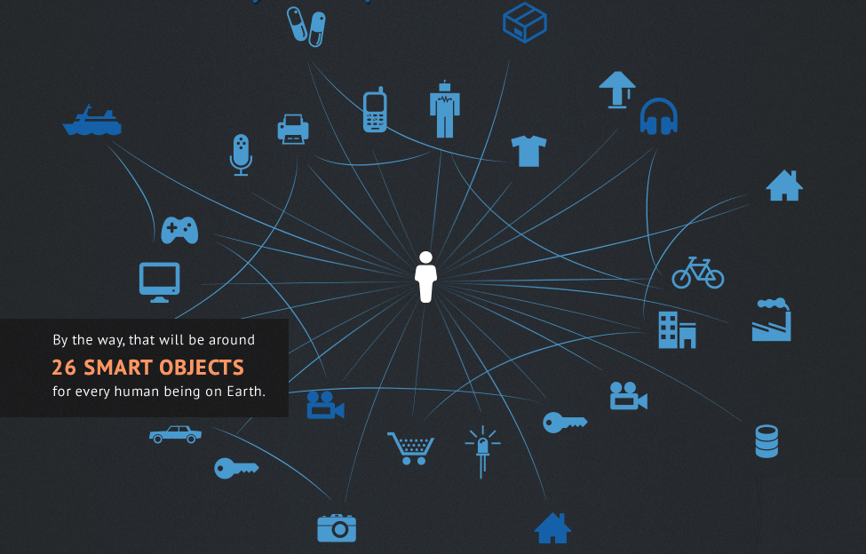
Connected World

Slide 8
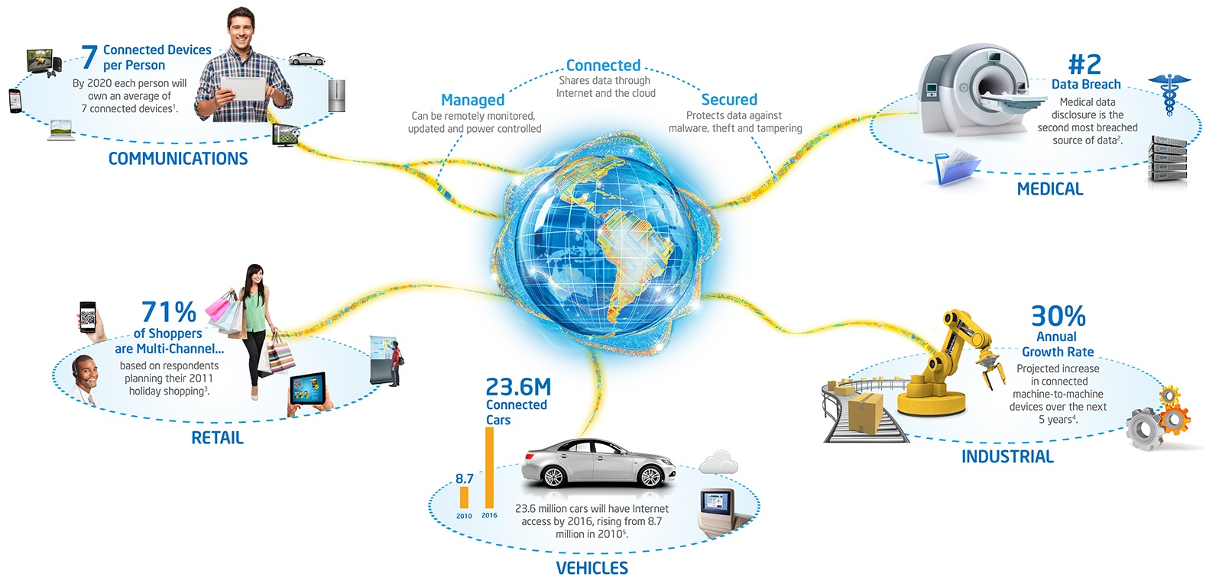

Slide 9
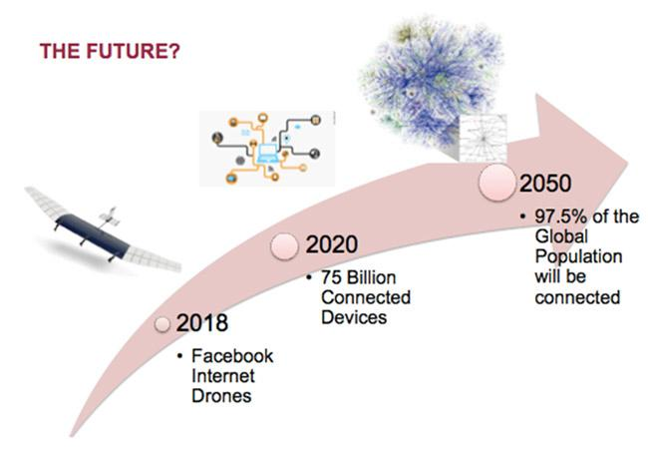
Notes:
https://www.isaca.org/Journal/Blog/Lists/Posts/Post.aspx?List=48c836c2-e659-4325-8553-6b5381f1fcd0&ID=297

Slide 10
Computer Exploits
An attack on an information system
Takes advantage of a particular system vulnerability
Often this attack is due to poor system design or implementation
Patch
“Fix” to eliminate the problem
Once the vulnerability is discovered, software developers quickly create and issue a “fix,” or patch, to eliminate the problem
Users are responsible for obtaining and installing
Delays expose users to security breaches

Slide 11
Zero-day attack
Before a vulnerability is discovered or fixed
A zero day vulnerability refers to a hole in software that is unknown to the vendor.
This security hole is then exploited by hackers before the vendor becomes aware and hurries to fix it—this exploit is called a zero day attack

Slide 12
IT SECURITY INCIDENTS
Year | Mail Messages Processed | Hotline Calls Received | Incidents Report Received
1997 | 39,626 | 1,058 | 2,134
1996 | 31,268 | 2,062 | 2,573
1995 | 32,084 | 3,428 | 2,412
1994 | 29,580 | 3,665 | 2,340
1993 | 21,267 | 2,282 | 1,334
1992 | 14,463 | 1,995 | 773
1991 | 9,629 | - | 406
1990 | 4,448 | - | 252
1989 | 2,869 | - | 132
1988 | 539 | - | 6

Slide 13
IT SECURITY INCIDENTS
Year | Mail Messages Processed | Hotline Calls Received | Incidents Report Received
2006 | 674,235 | 977 | -
2005 | 624,634 | 591 | -
2004 | 717,863 | 795 | -
2003 | 542,754 | 934 | 137,529
2002 | 204,841 | 880 | 82,094
2001 | 118,907 | 1,417 | 52,658
2000 | 56,365 | 1,280 | 21,756
1999 | 34,612 | 2,099 | 9,859
1998 | 41,871 | 1,001 | 3,734

Slide 14
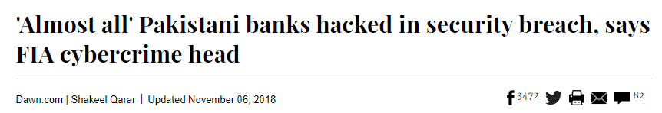
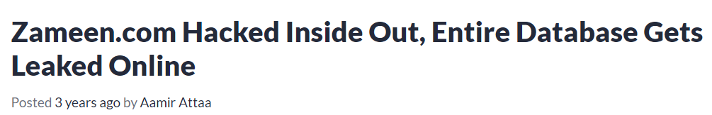
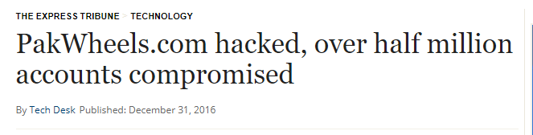
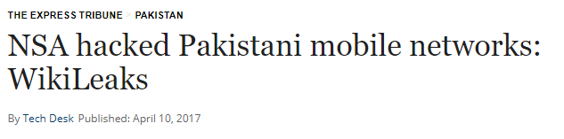
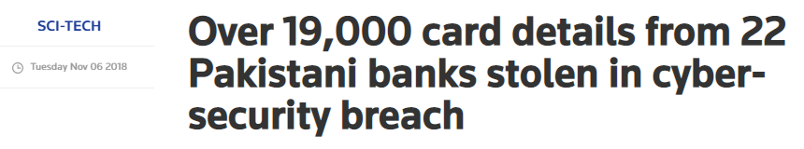
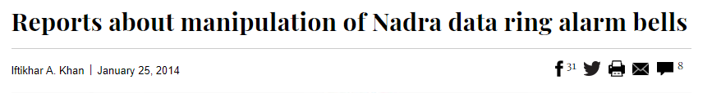

Slide 15
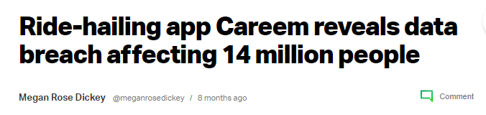
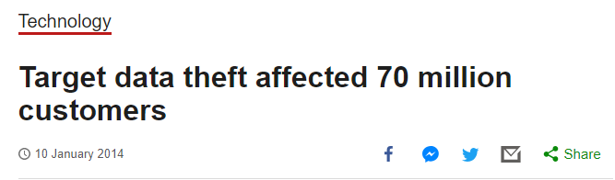
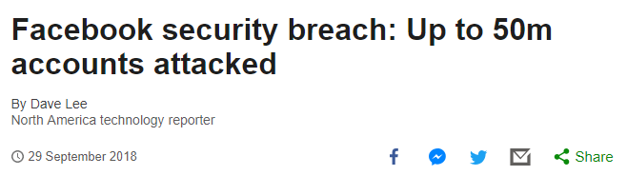
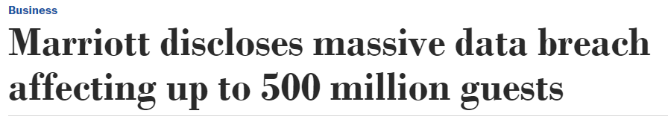
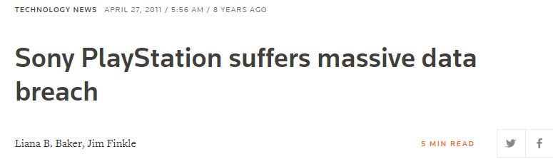
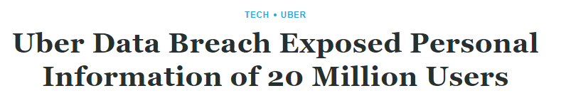

Slide 16
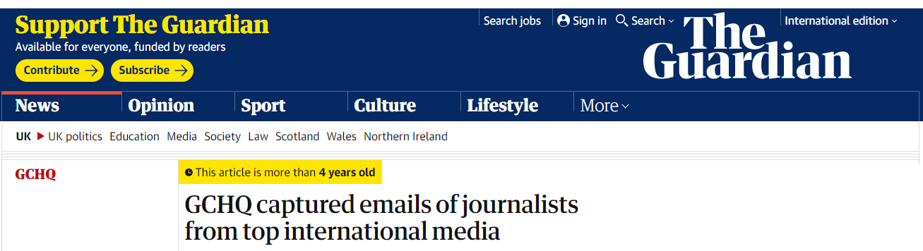
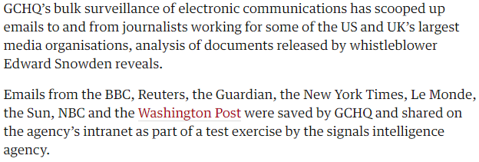

Slide 17
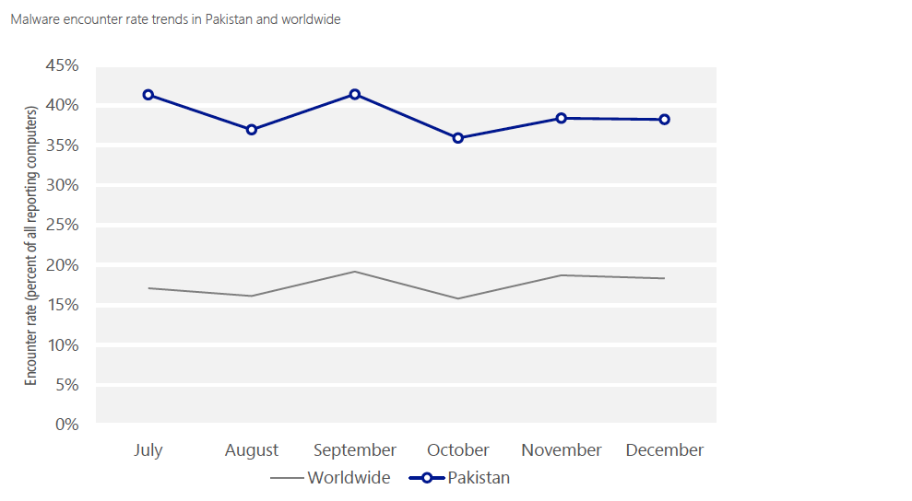

Slide 18
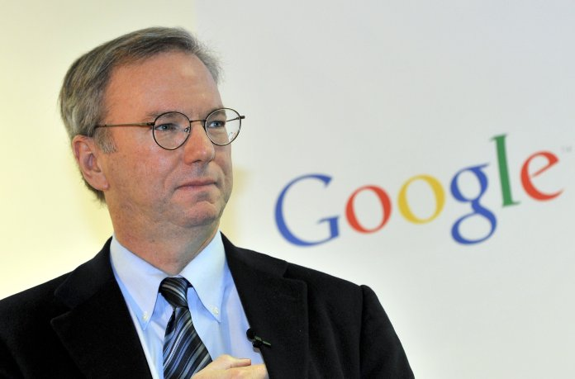
Eric Schmidt, the CEO of Google
"If you've got nothing to hide, you've got nothing to fear"
"If you have something that you don't want anyone to know, maybe you shouldn't be doing it in the first place, but if you really need that kind of privacy, the reality is that search engines including Google do retain this information for some time, and it's important, for example that we are all subject in the United States to the Patriot Act. It is possible that that information could be made available to the authorities."

Slide 19
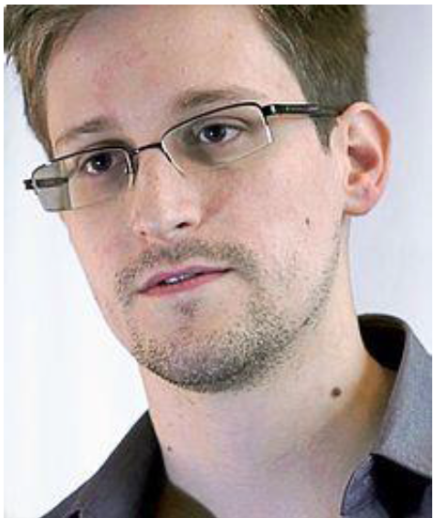
Who is he ?

Slide 20
Edward Joseph snowden
An American whistleblower who copied and leaked highly classified information from the National Security Agency in 2013 when he was a central Intelligence Agency employee.

Slide 21
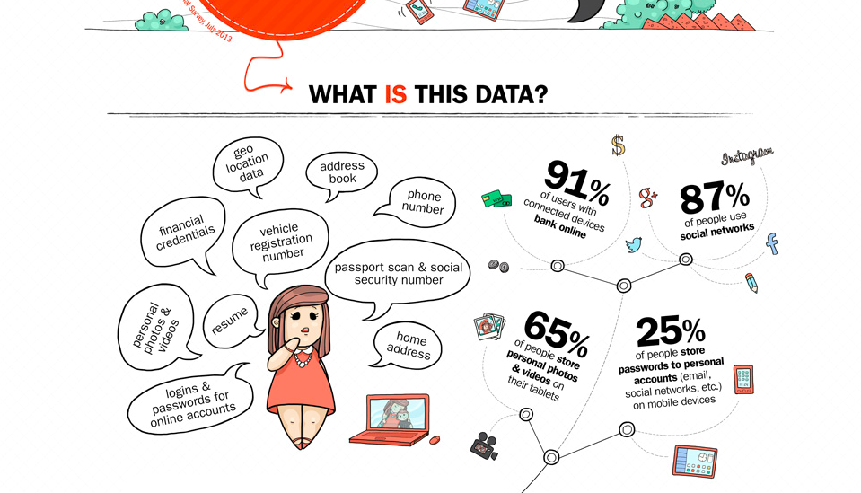

Slide 22
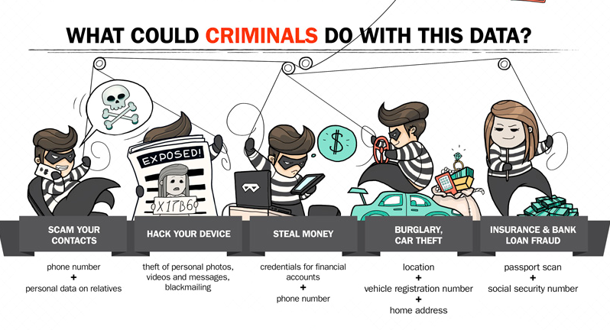

Slide 23
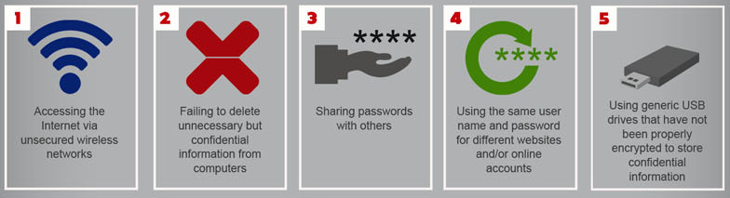


Slide 24
Types of Exploits
Computers as well as smartphones can be target
Types of attacks
Virus
Worm
Trojan horse
Distributed denial of service
Rootkit
Spam
Phishing (spear-phishing, smishing, and vishing)

Slide 25
Viruses
Pieces of malicious programming code
Usually disguised as something else
Cause unexpected and undesirable behavior
Often attached to files
Deliver a “payload”
Spread by actions of the “infected” computer user
Infected e-mail document attachments
Downloads of infected programs
Visits to infected Web sites

Slide 26
Viruses
A true virus does not spread itself from computer to computer
A virus is spread to other machines when a computer user opens an infected e-mail attachment, downloads an infected program, or visits infected Web sites.
Macro viruses have become a common and easily created form of virus.
Attackers use an application macro language (such as Visual Basic or VBScript) to create programs that infect documents and templates
Can not propagate without human intervention

Slide 27
Worms
Harmful programs
Reside in active memory of a computer
Duplicate themselves
Can propagate without human intervention
Negative impact of worm attack
Lost data and programs
Lost productivity
Additional effort for IT workers

Slide 28
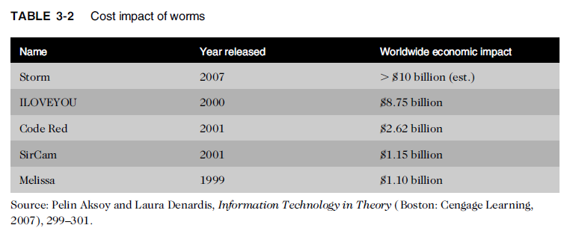
Worms

Slide 29
Trojan Horses
Malicious code hidden inside seemingly harmless programs
Users are tricked into installing them
Negative impact of Trojan attack:
destroy hard drives
corrupt files
control the computer remotely
launch attacks against other computers
Steal passwords or Social Security numbers
spy on users by recording keystrokes
Transmitting them to a server operated by a third party

Slide 30
Trojan Horses
iWork is the suite of applications created by Apple that includes word processing, desktop publishing, presentation preparation software, and a spreadsheet application.
Some pirated copies of this software contain a Trojan horse, iServices.a, which launches when the user begins installation of the pirated software.
When installed, the Trojan horse “phones home” to the hacker’s server to confirm the Mac is infected and awaits further instructions

Slide 31
Botnets
A large group of computers controlled from one or more remote locations by hackers, without the knowledge or consent of their owners
used to distribute spam and malicious code
Cutwail (a large botnet): controlled approximately one million active bots at one time
Dealing with “bot” computers within an organization’s network can be quite expensive

Slide 32
Botnets
Zeus botnets used millions of zombie computers to execute keystroke logging and form grabbing attacks that targeted bank data, account logins, and private user data. The information gathered by Zeus botnets has been used in thousands of cases of online identity theft, credit card theft, and more.

Slide 33
End of Lecture 2

